Slide 1



Session 3:
Neural Network
Convolutional Neural Network
1
Notes:
1

Slide 2
Outline
Artificial Neural Networks (ANN)
Overview
Structure
Convolutional Neural Networks (CNN)
Convolution Layer
Pooling Layer
Fully Connected Layer
Notes:
2

Slide 3
Outline
Artificial Neural Networks (ANN)
Overview
Structure
Convolutional Neural Networks (CNN)
Convolution Layer
Pooling Layer
Fully Connected Layer
Notes:
3

Slide 4
What are Artificial Neural Networks?
An Artificial Neural Network (ANN) is an information processing paradigm that is inspired by the biological nervous systems, such as the human brain’s information processing mechanism.
The key element of this paradigm is the novel structure of the information processing system. It is composed of a large number of highly interconnected processing elements (neurons) working in unison to solve specific problems. NNs, like people, learn by example.
An NN is configured for a specific application, such as pattern recognition or data classification, through a learning process. Learning in biological systems involves adjustments to the synaptic connections that exist between the neurons. This is true of NNs as well.
(ref) Jiang, Jianmin, P. Trundle, and Jinchang Ren. "Medical image analysis with artificial neural networks." Computerized Medical Imaging and Graphics 34.8 (2010): 617-631.

Slide 5
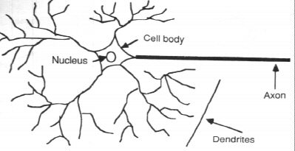
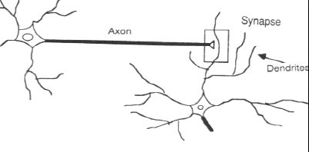
How the Human Brain learns
In the human brain, a typical neuron collects signals from others through a host of fine structures called dendrites.
The neuron sends out spikes of electrical activity through a long, thin stand known as an axon, which splits into thousands of branches.
At the end of each branch, a structure called a synapse converts the activity from the axon into electrical effects that inhibit or excite activity in the connected neurons.
(ref) Neural Networks by Eric Davalo and Patrick Naim

Slide 6
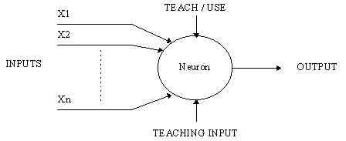
A Simple Neuron
An artificial neuron is a device with many inputs and one output.
The neuron has two modes of operation;
the training mode and
the using mode.

Slide 7
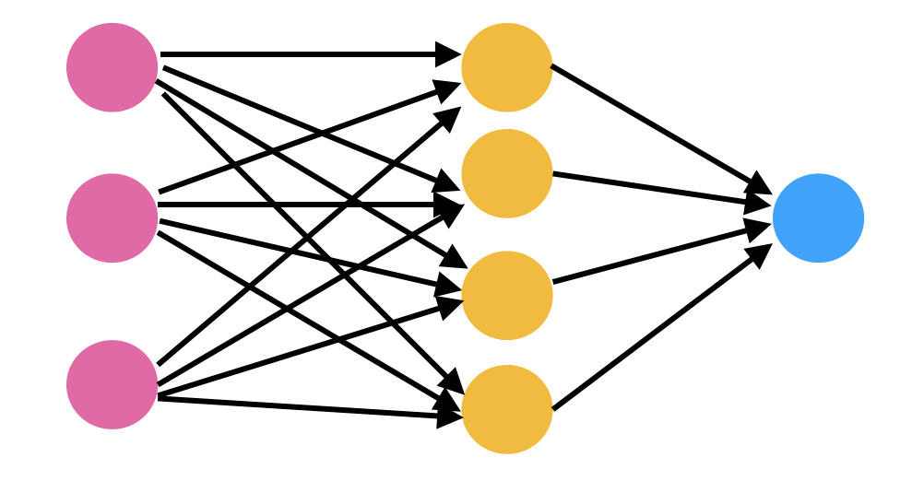
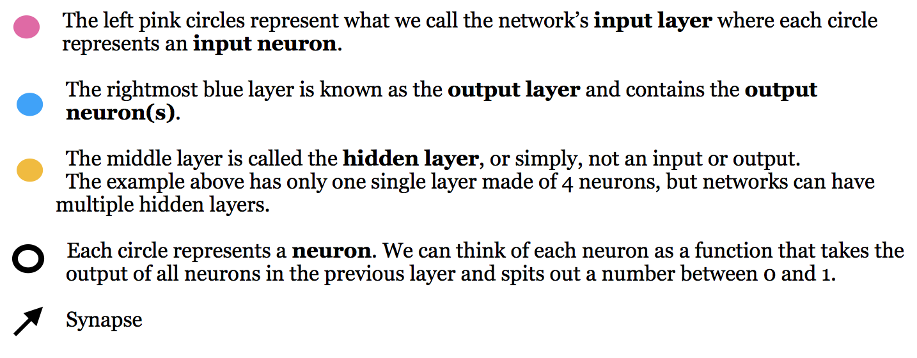
Structure of Neural Networks
(ref) Understanding the Structure of Neural Networks by Savannah Logan

Slide 8
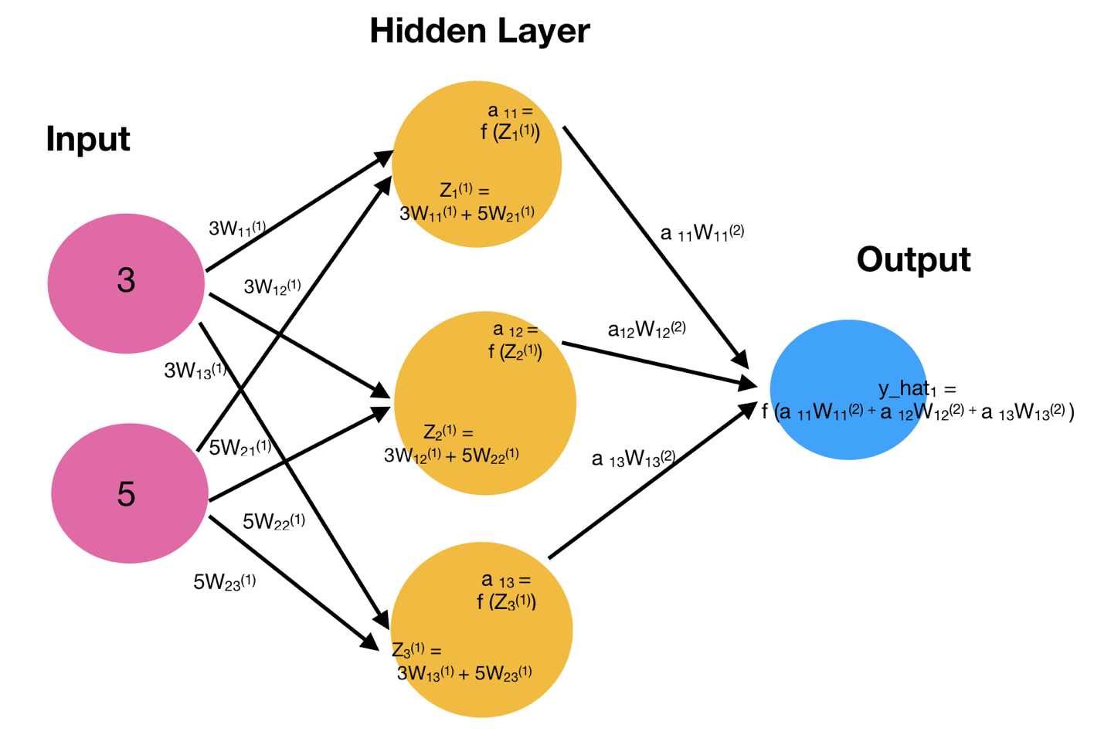
Hidden Layer
(ref) Understanding the Structure of Neural Networks by Savannah Logan

Slide 9

Activation Function
(ref) Understanding Activation Functions in Neural Networks by Avinash Sharma V
(ref) https://towardsdatascience.com/activation-functions-neural-networks-1cbd9f8d91d6
Notes:
Now, the value of Y can be anything ranging from -inf to +inf. The neuron really doesn’t know the bounds of the value. So how do we decide whether the neuron should fire or not ( why this firing pattern? Because we learnt it from biology that’s the way brain works and brain is a working testimony of an awesome and intelligent system ).

Slide 10
Outline
Artificial Neural Networks (ANN)
Overview
Structure
Convolutional Neural Networks (CNN)
Convolution Layer
Pooling Layer
Fully Connected Layer
Notes:
10

Slide 11
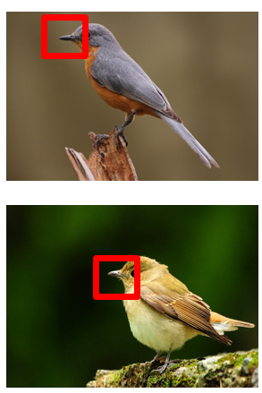
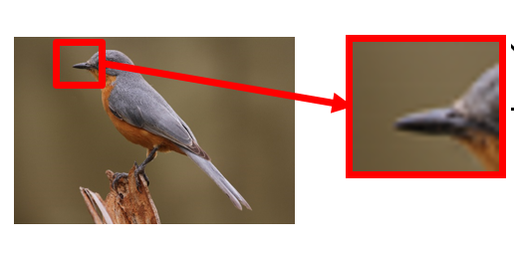
Motivation of CNN
Consider learning an image, some patterns are much smaller than the whole image → Can represent a small region with fewer parameters
Same pattern appears in different places: → What about training a lot of such “small” detectors and each detector must “move around”.
Notes:
Now, the value of Y can be anything ranging from -inf to +inf. The neuron really doesn’t know the bounds of the value. So how do we decide whether the neuron should fire or not ( why this firing pattern? Because we learnt it from biology that’s the way brain works and brain is a working testimony of an awesome and intelligent system ).

Slide 12
Three main layers in CNN
Convolution (CONV)
Pooling layer (POOL)
Fully connected (FC)
Notes:
Now, the value of Y can be anything ranging from -inf to +inf. The neuron really doesn’t know the bounds of the value. So how do we decide whether the neuron should fire or not ( why this firing pattern? Because we learnt it from biology that’s the way brain works and brain is a working testimony of an awesome and intelligent system ).

Slide 13
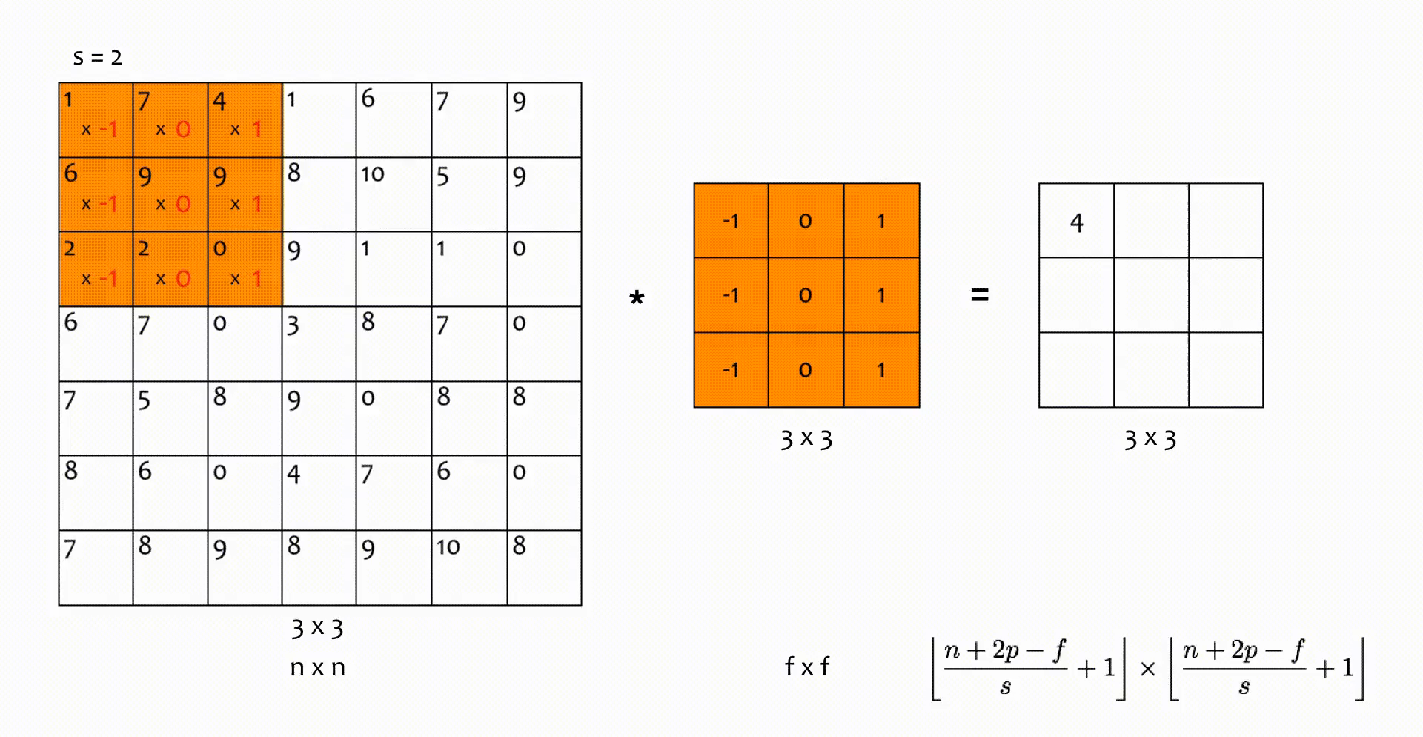
Convolution Layer
7 x 7
n x n
Notes:
Now, the value of Y can be anything ranging from -inf to +inf. The neuron really doesn’t know the bounds of the value. So how do we decide whether the neuron should fire or not ( why this firing pattern? Because we learnt it from biology that’s the way brain works and brain is a working testimony of an awesome and intelligent system ).

Slide 14
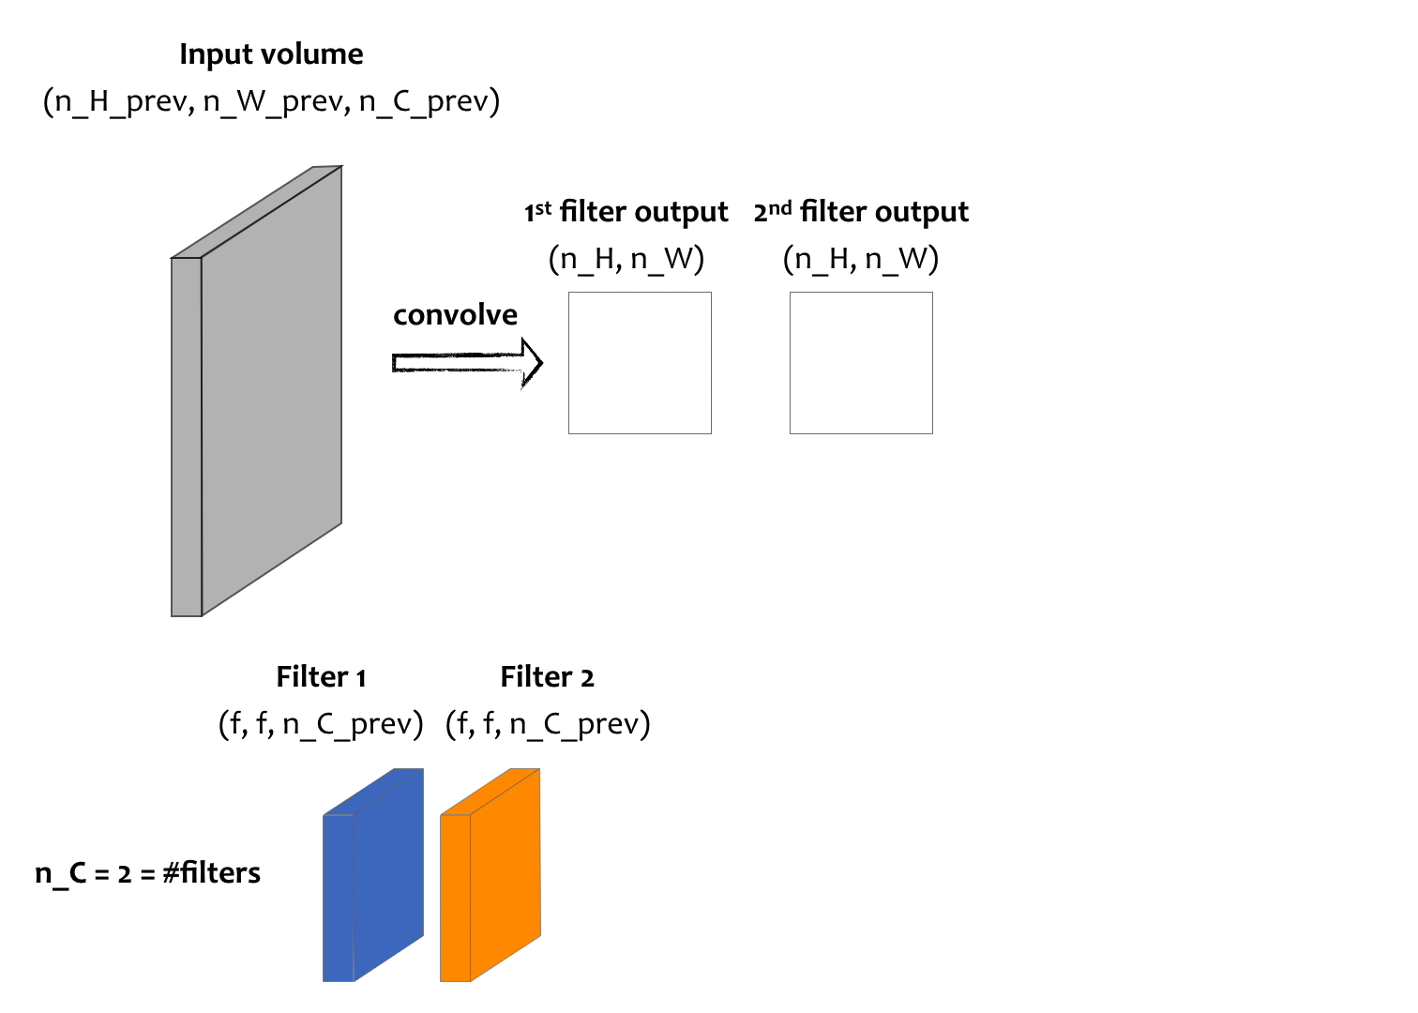
Convolution Layer (tt)
Notes:
Now, the value of Y can be anything ranging from -inf to +inf. The neuron really doesn’t know the bounds of the value. So how do we decide whether the neuron should fire or not ( why this firing pattern? Because we learnt it from biology that’s the way brain works and brain is a working testimony of an awesome and intelligent system ).

Slide 15
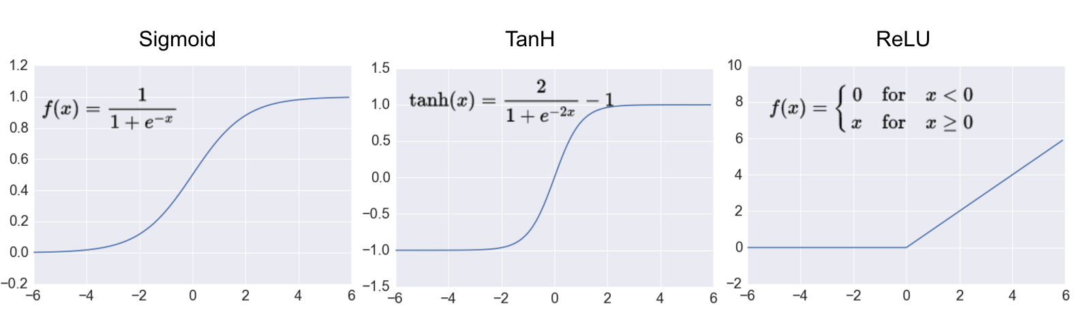
Activation Function
Once the feature maps are extracted, the next step is to move them to activation function
Notes:
Now, the value of Y can be anything ranging from -inf to +inf. The neuron really doesn’t know the bounds of the value. So how do we decide whether the neuron should fire or not ( why this firing pattern? Because we learnt it from biology that’s the way brain works and brain is a working testimony of an awesome and intelligent system ).

Slide 16
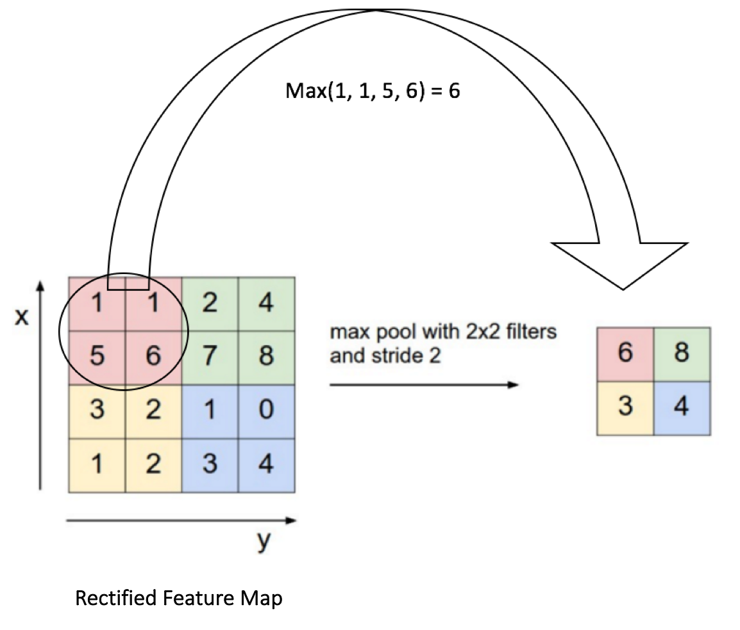
Pooling Layer
Pooling is a down-sample operation that reduces the dimensional of feature map.

Slide 17
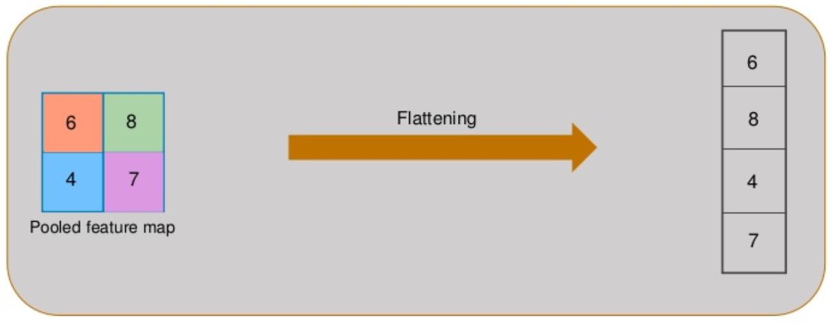
Flatten
Flattening is the process of converting all the resultant 2 dimensional arrays from pooled feature map into single long continuous linear vector.

Slide 18
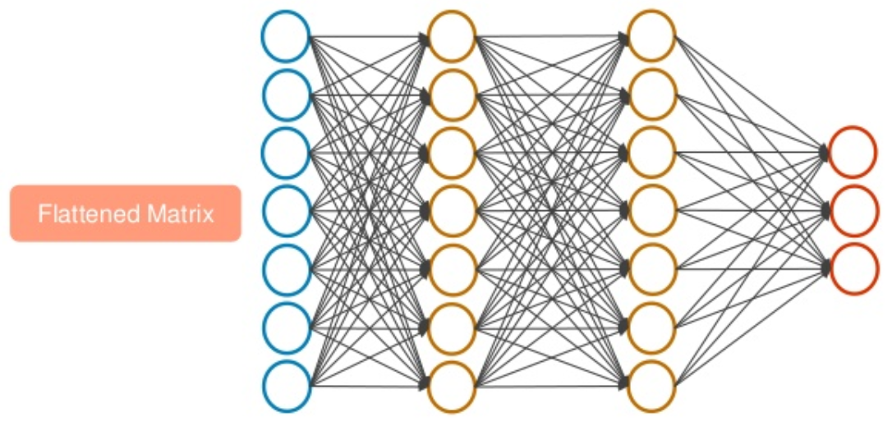
Fully Connected Layer
The Flattened matrix from the pooling layer is fed as input to the Fully Connected Layer to classify the image

Slide 19
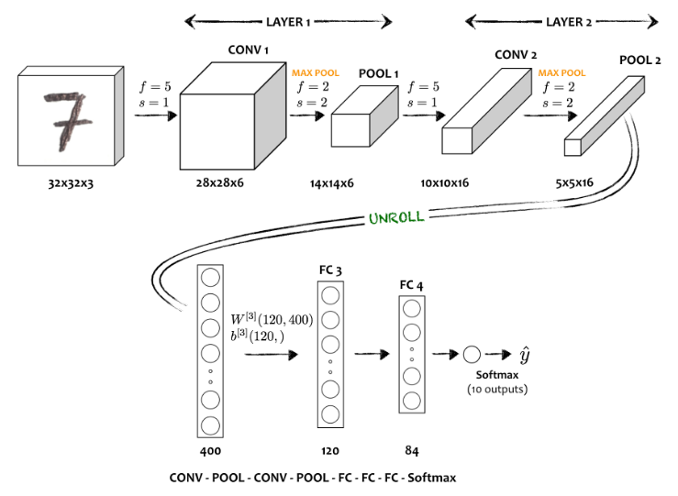
Simple CNN model

Slide 20
Q&A

Slide 21
Thank you!

Slide 22
Advantages of CNN
Sparse Representations
Parameter Sharing
Equivariance
Notes:
Now, the value of Y can be anything ranging from -inf to +inf. The neuron really doesn’t know the bounds of the value. So how do we decide whether the neuron should fire or not ( why this firing pattern? Because we learnt it from biology that’s the way brain works and brain is a working testimony of an awesome and intelligent system ).

Slide 23
